Slide 1
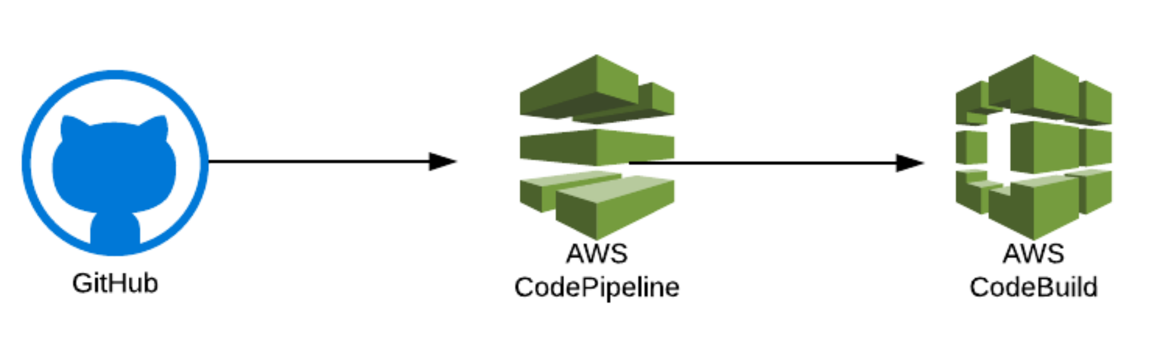
AWS DevOps CI/CD
javatechie

Slide 2
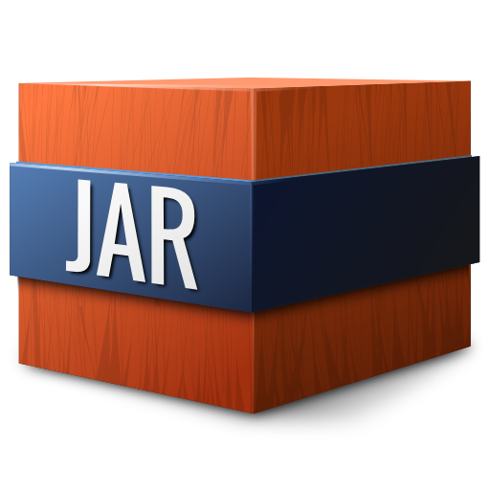


Why We need CI/CD ?
Microservice Application
Elastic Beanstalk

Slide 3
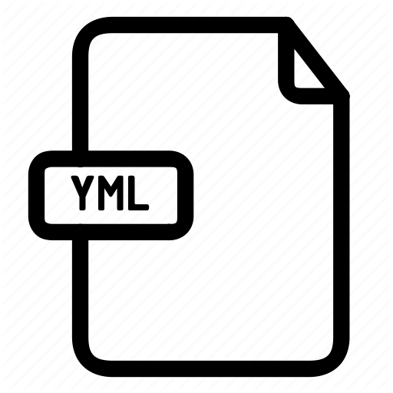



Integration Flow ?
buildspec.yml
GitHub
AWS Code Build
Elastic Beanstalk
Microservice App

